Slide 1
Workshop 2: Using Arduino: Intro to Arduino Control an LED

Slide 2
Overview:
Learning outcome:
Basics of Arduino programming (C programming, compiling code).
C programming: 45 min
Arduino programming: 20 min
Compiling code: 10 min

Slide 3
C programming
Go to https://repl.it/languages/c
Go through the Programming-1 workshop

Slide 4
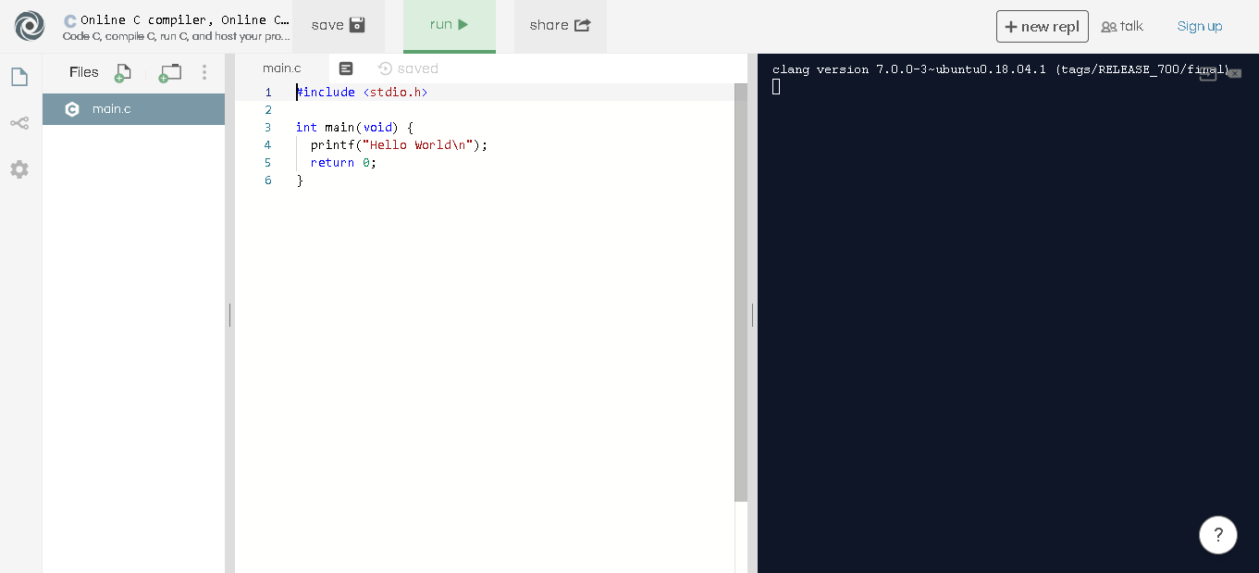

Slide 5
How to think of Boolean expressions
A combination of Boolean variables is a Boolean expression
Ex: x AND y, NOT x, x
Boolean expressions are, themselves, either true or false
The easiest way to process Boolean expressions is with if statements
I’ll do ‘B’ if ‘A’
You would only do B if A is true.

Slide 6
How to think of Boolean expressions
A = x OR y
I’ll do B if x OR y
I’ll go to sleep if it’s later than 1am OR my phone runs out of battery
Will go to sleep as long as 1 of the 2 is true
A = x AND y
I’ll do B if x AND y
I’ll go to sleep if it’s later than 1am AND my phone runs out of battery
You aren’t sleeping until both conditions are true

Slide 7
Programming an Arduino using the Arduino IDE
Teach what an Arduino is
background information
how does it work
what is it
does it taste good

Slide 8
What is an Arduino?
Microprocessor. Has programmable pins that allow you to read data from sensors and send data to other

